Slide 1
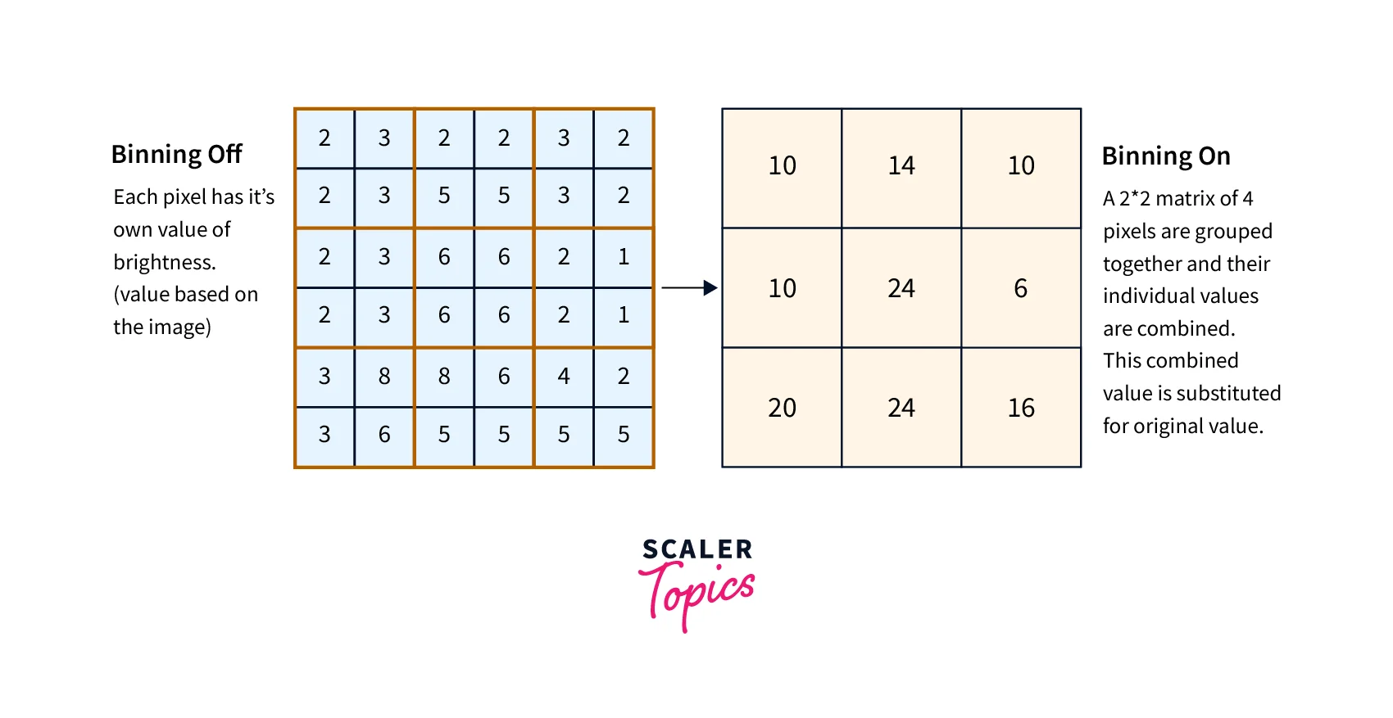
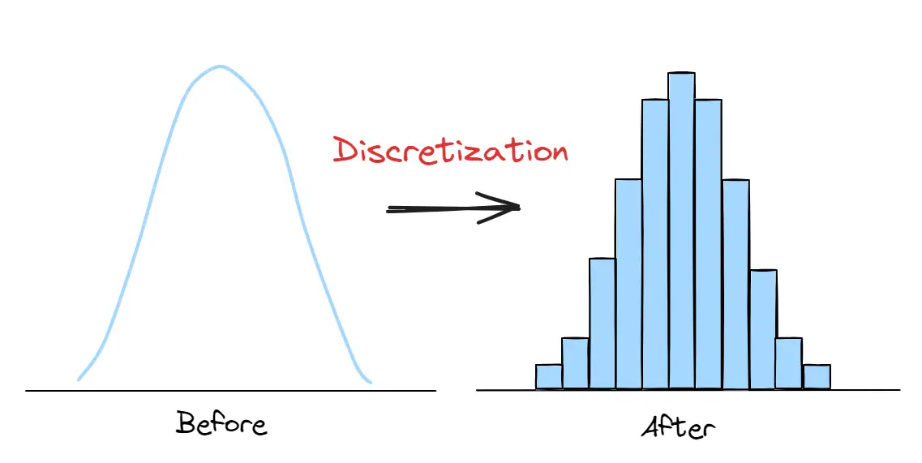
Binning & Discretization (From Scalars to Groups)
The Concept: Reducing the "noise" of continuous numbers by grouping them into meaningful bins.
Why it works: Sometimes the exact value (e.g., Age 22 vs 23) is less important than the category (e.g., Student vs Professional).
Types:
Equal Width: Bins of equal size.
Equal Frequency (Quantiles): Bins with the same number of data points.

Slide 2
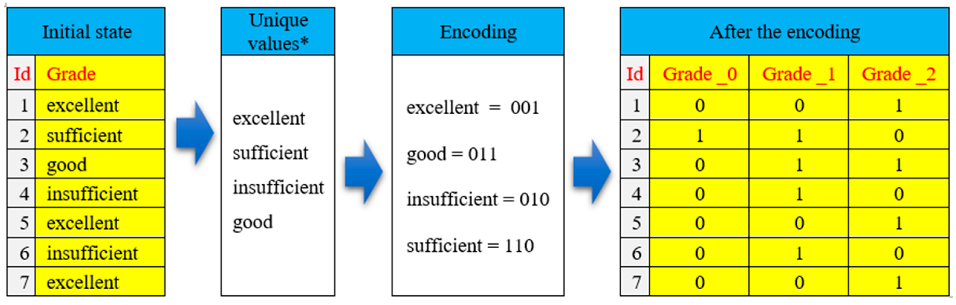
Encoding Categorical Data (Talking to the Machine)
The Problem: Algorithms only understand math, not words like "Peshawar" or "Medical."
Label Encoding: Assigning a unique integer to each category (0, 1, 2...). Best for "Ordinal" data where order matters (Small, Medium, Large).
One-Hot Encoding: Creating a new binary column (0 or 1) for every unique category. Best for "Nominal" data where no order exists (City names).

Slide 3
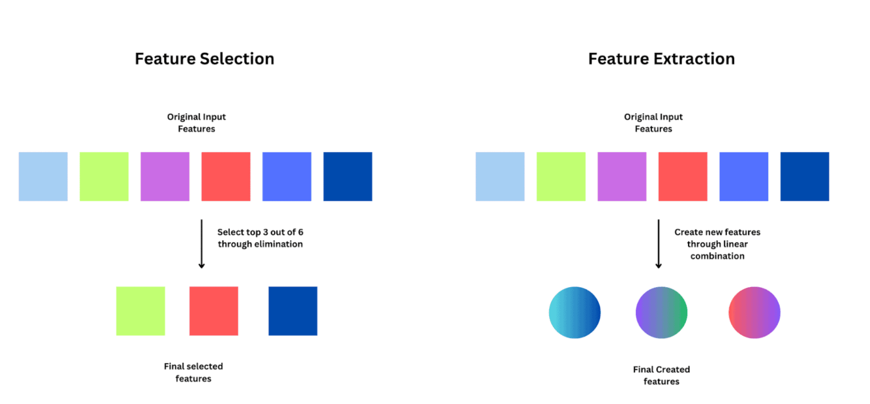
Feature Extraction (Synthesizing New Insights)
Definition: Creating new variables from existing ones to expose hidden patterns.
Date/Time Extraction: Breaking a "Timestamp" into 'Hour of Day', 'Day of Week', or 'Is Weekend'.
Mathematical Extraction: Creating a 'Price per Square Foot' column from 'Total Price' and 'Area'.
Domain Specific: In medical imaging, extracting the 'Aspect Ratio' of a detected cell.

Slide 4
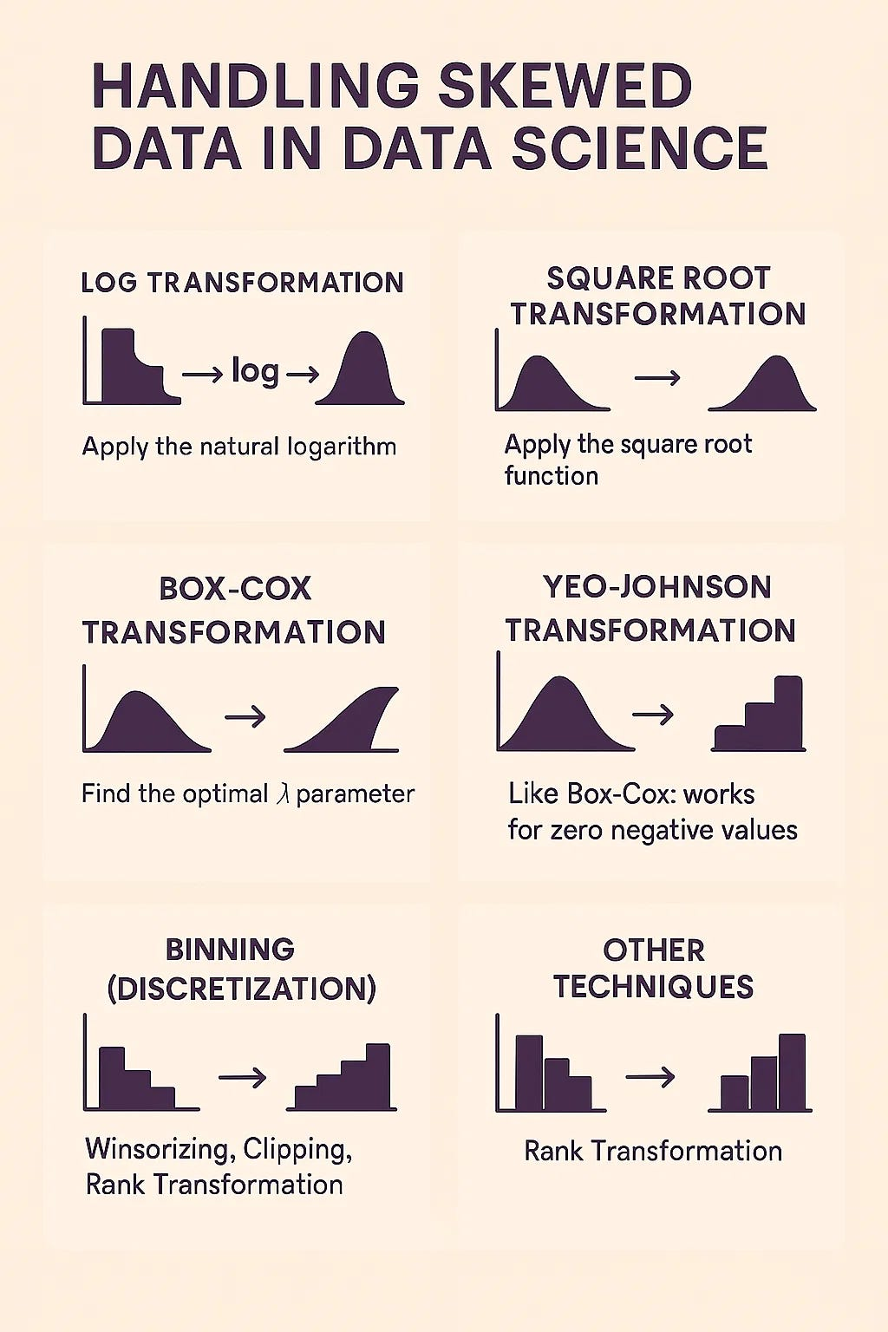
Handling Skewed Data (The Log Transform)
The "Bunching" Problem: Real-world data (like wealth or rainfall) is often skewed, with most values bunched on the left and a few extreme values on the right.
Log Transformation: Applying log(x) "pulls in" the extreme outliers and spreads out the bunched values.
The Result: A distribution that looks "Normal" (Bell Curve), which is a requirement for many statistical models.

